Slide 1
Rounding to any number of decimal places
Task A: Rounding to a given number of decimal places
1) Complete the following table:
Number | to 1 d.p. | to 2 d.p. | to 3 d.p.
14.25342
765.3246
2035.83716
7.658192
82.82926
0.63492
0.08739
0.2995
2) Using the clues, find the numbers being described:
a) Clue 1 − I am between 2 and 3.
Clue 2 − I have 3 digits after the decimal point.
Clue 3 − When rounded to 2 decimal places I am 2.88.
Clue 4 − My hundredths digit is greater than my thousandths digit.
Clue 5 − The difference between my tenths and thousandths digits is 2.
I am .
b) Clue 1 − I am between 1 and 2.
Clue 2 − I have 3 digits after the decimal point.
Clue 3 − When rounded to 1 decimal place I am 1.9.
Clue 4 − When rounded to 2 decimal places I am 1.90.
Clue 5 − The sum of my tenths and thousandths column is 13.
I am .

Slide 2
Rounding to any number of decimal places
2) Using the clues find the numbers being described:
c) Clue 1 − I am between 0 and 1.
Clue 2 − I have 3 digits after the decimal point.
Clue 3 − When rounded to 1 decimal place I am 0.1.
Clue 4 − When rounded to 2 decimal places I am 0.08.
Clue 5 − My hundredths column is double my thousandths column.
I am .
Task B: Rounding in a context
1) 3 friends go out for lunch and spend £25. They decide that there are 3 different ways they can pay.
a) Write down the pros and cons of the different ways.
i) Round the cost to the nearest £10 and split the bill.
ii) Split the bill between the 3 of them, round this to the nearest pound and each pay that amount.
iii) Split the bill between the 3 of them, round to 2 decimal places and each pay that amount.
b) What should they do to pay for the lunch?

Slide 3
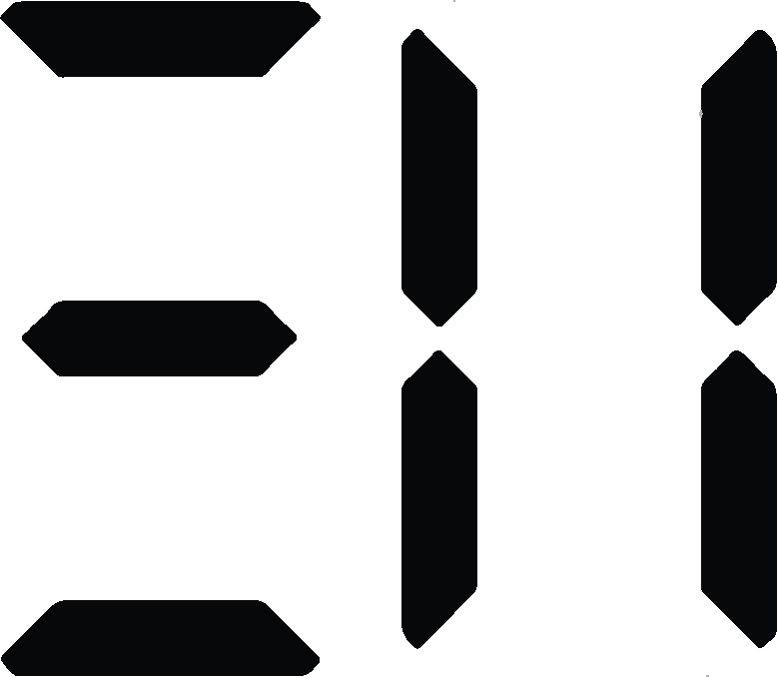
Rounding to any number of decimal places
2) Work out the cost of carpeting the following:
a)
b)
7.2 m
£6.25 per m²
6.8 m
5.1 m
4.2 m
£5.95 per m²
2.84 m
8.08 m
3) Lucas, Aisha and Jacob take part in 800 m on sports day. The teacher recorded their times to the nearest minute.
Here are their times:
Lucas Aisha Jacob
3 minutes 3 minutes 3 minutes
a) Was rounding to the nearest minute a suitable degree of accuracy?
b) The teacher then decides to record their times to the nearest hundredth of a second. Is this an appropriate degree of accuracy?
Here are their exact times:
Lucas Aisha Jacob
c) Was it necessary to record the times to the nearest 100th of a second?
Mathematics in Education and Industry
v2.3

